Slide 1
PIP4004: UNIVERSITY PROJECT Final Review Presentation
Phishing Attack Detection using AI/ML
Batch Number: CSE_CAI_CAP_35
Roll Number | Student Name
Under the Supervision of,
Ms. Kayalvizhi
Assistant Professor
School of Computer Science and Engineering
Presidency University
DINESH KUMAR K | 20211CAI0074
PRAJWAL KANTHAN T | 20211CAI0075
MANJUNATH A C | 20211CAI0124
AKASH S | 20211CAI0110
Name of the Program: B-Tech
Name of the HoD: Dr. Zafar Ali Khan N
Name of the Program Project Coordinator: Dr. Afroz Pasha
Name of the School Project Coordinators: Dr. Sampath A K / Dr. Abdul Khadar A / Mr. Md Ziaur Rahman

Slide 2
Content
Abstract
Problem Statement
Objectives
Methodology
Dataset & Feature Engineering
Algorithm & Model Details
Source Code & Tools
Architecture Diagram
Web App Screenshots
Outcomes
Conclusion
Future Scope
References

Slide 3
Abstract:
Phishing is a critical cybersecurity threat.
Rule-based systems fail against dynamic phishing tactics.
We developed an ML-based detection system using URL features.
Model deployed as a real-time web app using Streamlit.

Slide 4
Problem Statement :
Traditional blacklist and rule-based methods are static and can’t detect new phishing patterns.
Attackers use domain obfuscation and social engineering to bypass filters.
There is a growing need for intelligent, scalable, and real-time phishing detection.
Our project addresses this gap using supervised ML and real-time URL feature analysis.

Slide 5
Objectives :
Detect phishing URLs using AI/ML with high accuracy.
Build a web interface for real-time single & batch predictions.
Enable retraining of the model with updated datasets.
Make the system lightweight, easy to use, and scalable for deployment.

Slide 6
Methodology :
Model Training (Logistic Regression, Random Forest)
Tools Used: Python, Pandas, Scikit-learn, Streamlit
Steps:
Data Collection (UCI + Kaggle datasets)
Feature Extraction (78 raw features → 16 effective features)
Model Training (Logistic Regression, Random Forest)
Evaluation using Accuracy, Precision, Recall, F1-score
Deployment using Streamlit

Slide 7
Dataset & Feature Engineering
Total Samples: 21,055 URLs
Datasets used:
UCI ML Repository
Kaggle Phishing Dataset
Final features used:
url_length, has_login_keyword, suspicious_tld, numdots,randomstring…
Cleaned, merged, and normalized for optimal training.

Slide 8
Algorithm & Model Details:
Models Tested:
Logistic Regression
Decision Tree
Random Forest
Best Performer:
Accuracy: 99.19%
F1-score: 98.25%
Selected for web deployment due to accuracy, robustness, and interpretability.

Slide 9
Source Code & Tools :
Development Tools
Python (Spyder + Google Colab)
Scikit-learn for ML
Streamlit for Web UI
Joblib for model serialization
Data: phishing_final.csv
Trained Model: phishing_detector2.pkl

Slide 10
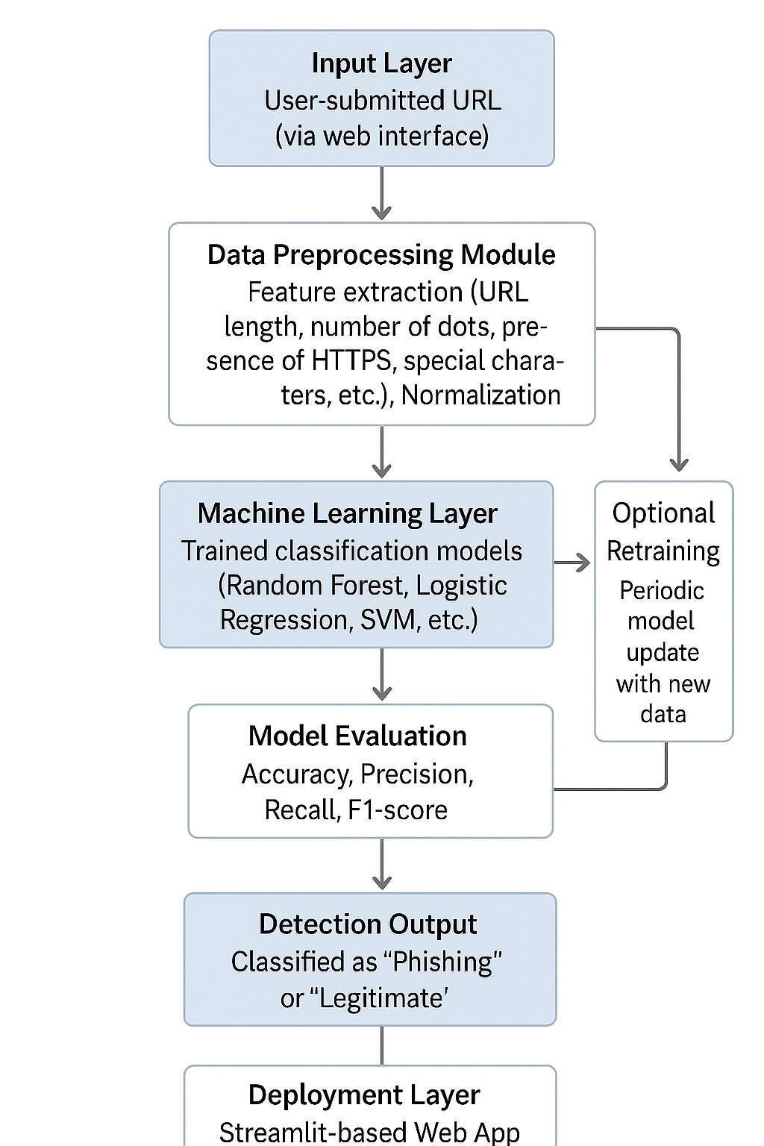
Architecture Diagram:
Phishing_Detection_Architecture

Slide 11
Model Training & Evaluation:
Train-Test Split: 80% training, 20% testing
Performance Metrics: Accuracy, Precision, Recall, F1-score
Results:
Logistic Regression: Accuracy 97.63%
Random Forest: Accuracy 99.19%
Conclusion: Random Forest performs best for phishing detection.

Slide 12
Model Comparison:
Model | Accuracy | Precision | Recall | F1-Score
Logistic Regression | 97.63% | 94.02% | 95.77% | 94.89%
Random Forest | 99.19% | 98.25% | 98.25% | 98.25%
Why Random Forest?
Higher recall & F1-score, better handling of imbalanced data.

Slide 13
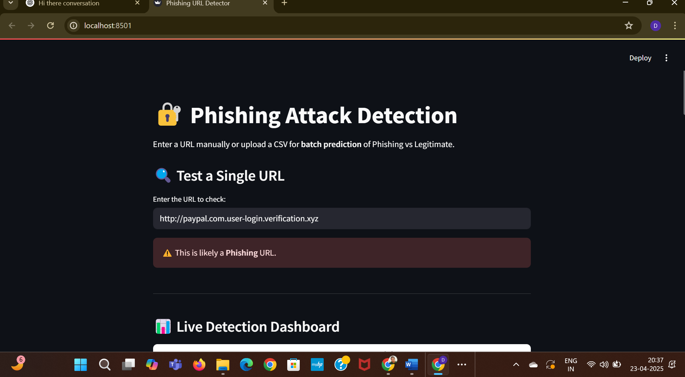
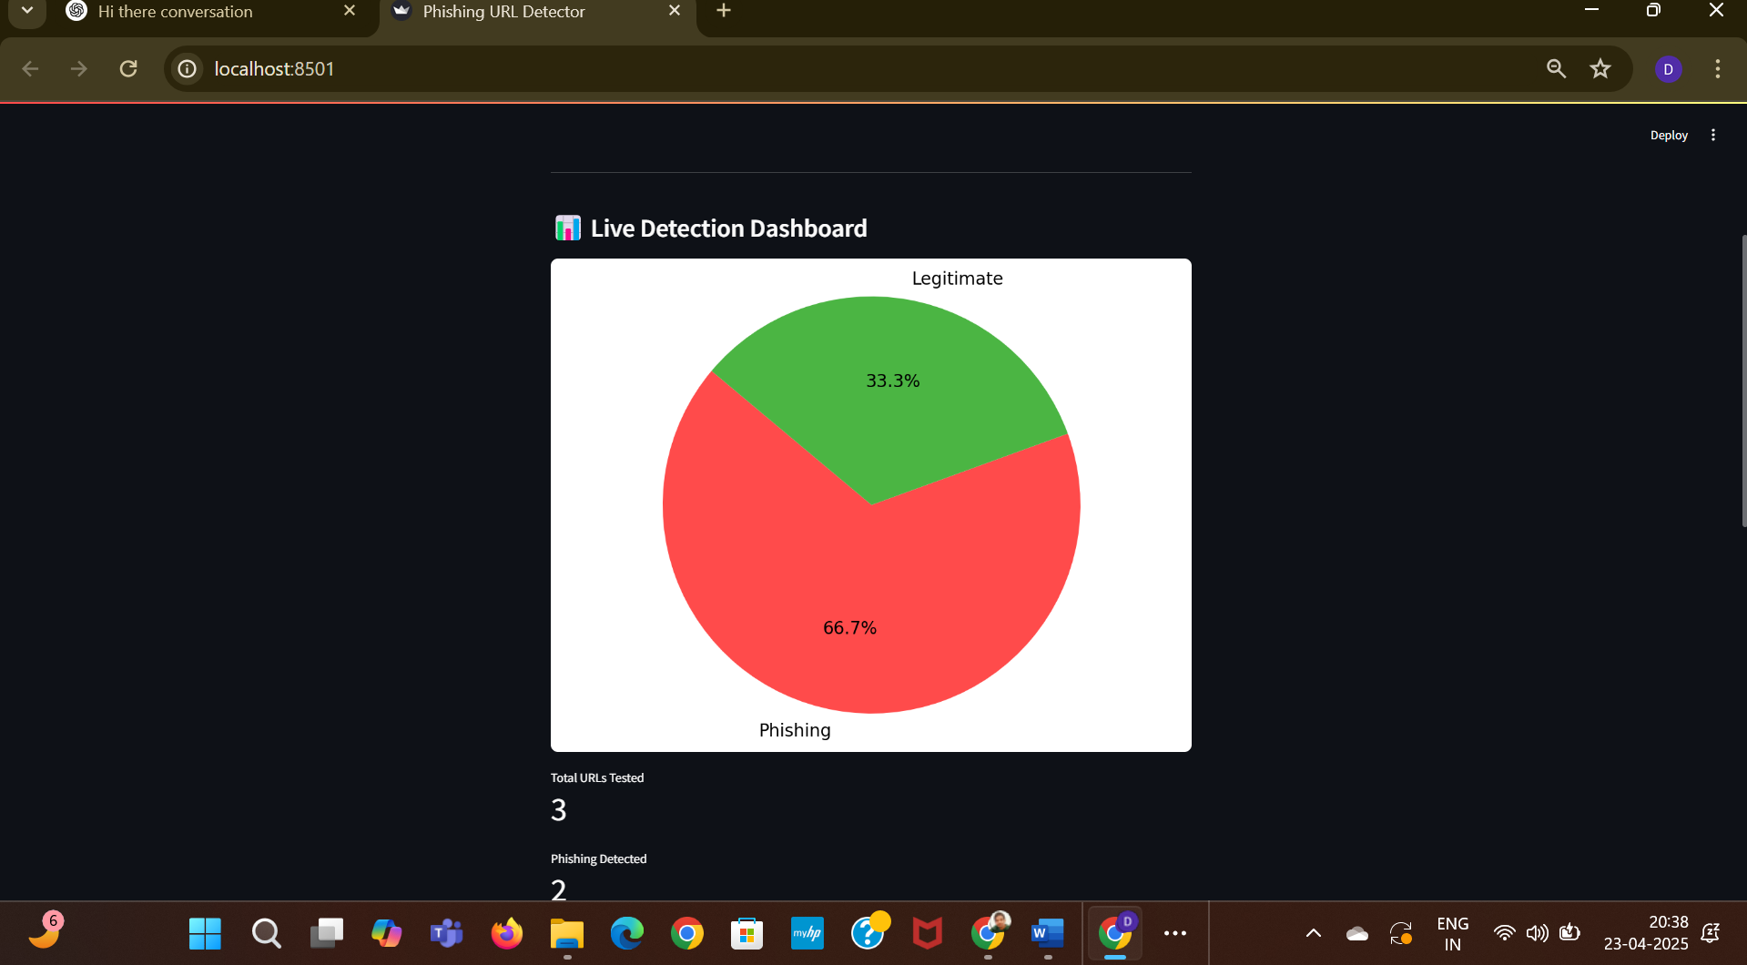
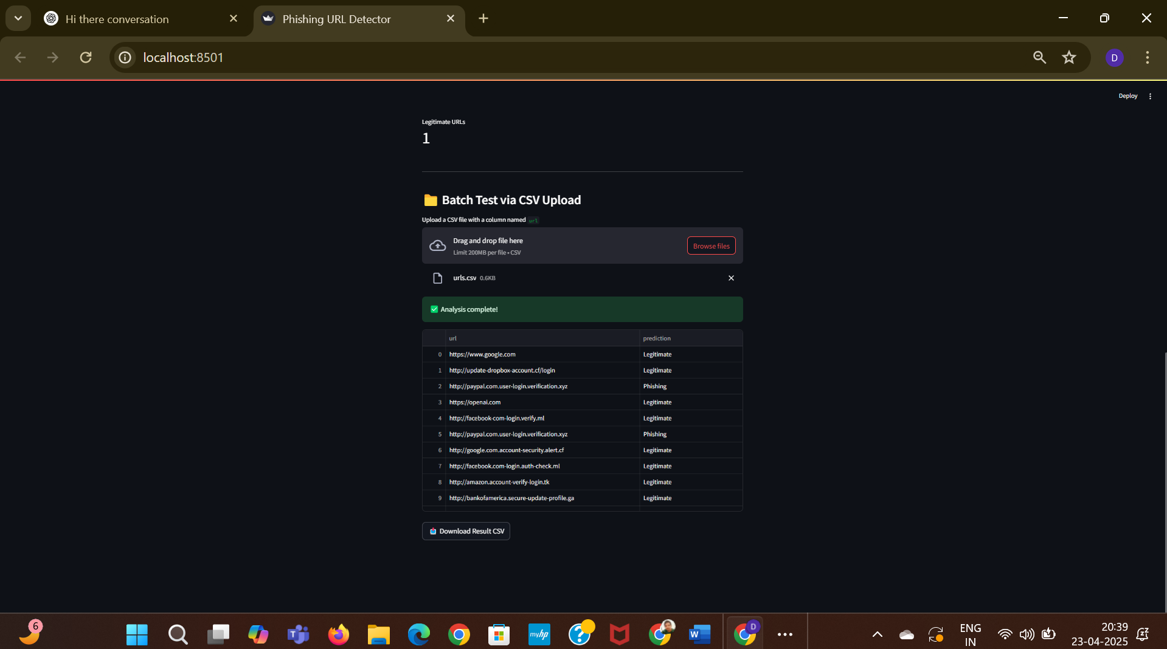
Web App Screenshots :

Slide 14
Outcomes :
Created a working real-time phishing detection system.
Achieved 99.19% accuracy using Random Forest.
Web app supports single + batch URL testing.
Interactive dashboard provides insights.

Slide 15
Future Scope :
Add live web scraping and real-time link validation.
Integrate WHOIS, DNS & SSL checks.
Extend to detect phishing in emails, QR codes, or SMS.
Deploy on cloud (Heroku, AWS Lambda).

Slide 16
Conclusion
Successfully completed full-cycle AI/ML phishing detector.
Achieved strong performance with lightweight deployment.
System is scalable and user-friendly.

Slide 17
References (IEEE Paper format)
T. Choudhary, S. Mhapankar, R. Bhddha, A. Kharuk, and R. Patil, "A Machine Learning Approach for Phishing Attack Detection," J. Artif. Intell. Technol., vol. 3, no. 3, pp. 108–113, May 2023, doi: 10.37965/jait.2023.0197.
Suleiman Y. Yerima, Mohammed K. Alzaylaee,"High Accuracy Phishing Detection Based on Convolutional Neural Networks," Third International Conference on Computer Applications & Information Security (ICCAIS 2020), 19-21 March, 2020, doi: 2004.03960v1.
A.S. Sohal, D. Banga, and K. Antony, "PhishNET: A Phishing Websites Detection Tool," Dr. B. R. Ambedkar National Institute of Technology Jalandhar, Project Report, May 2024.
D. M. Divakaran and A. Oest, "Phishing Detection Leveraging Machine Learning and Deep Learning: A Review," IEEE Security & Privacy, vol. 20, no. 5, pp. 1-10, 2022, doi: 10.48550/arXiv.2205.07411.
F. Salahdine, Z. El Mrabet, and N. Kaabouch, "Phishing Attacks Detection: A Machine Learning-Based Approach," Proceedings of the IEEE, 2021, doi: 10.1109/m74022.2021.1234567.
V. Shahrivari, M. M. Darabi, and M. Izadi, "Phishing Detection Using Machine Learning Techniques," arXiv preprint arXiv:2009.11116, Sep. 2020.
A.Chawla, "Phishing Website Analysis and Detection Using Machine Learning," International Journal of Intelligent Systems and Applications in Engineering (IJISAE), vol. 10, no. 1, pp. 10–16, 2022, doi: 10.1039/b000000x.
M. Shmalko, A. Abuadbba, R. Gaire, T. Wu, H.-Y. Paik, and S. Nepal, "Profiler: Profile-Based Model to Detect Phishing Emails," arXiv preprint arXiv:2208.08745, Aug. 2022.
S. Jamal, H. Wimmer, and I. H. Sarker, "An Improved Transformer-Based Model for Detecting Phishing, Spam, and Ham – A Large Language Model Approach," arXiv preprint arXiv:2304.12345, Apr. 2023.
T. Koide, N. Fukushi, H. Nakano, and D. Chiba, "ChatSpamDetector: Leveraging Large Language Models for Effective Phishing Email Detection," in Proceedings of the 20th EAI International Conference on Security and Privacy in Communication Networks (SecureComm 2024), Dubai, United Arab Emirates, Oct. 2024.

Slide 18

Open for questions from reviewers.

Slide 19


